Slide 1
www.zeitfuerdeutsch.com

Slide 2
House 1 and Rooms Haus 1 und Zimmer
LO: Talk about a house
SC
I can name the rooms in a house
I can identify a room from a picture
I can play charades in German
I can use the German verb ‘to be’
I can translate sentences about a house by using ‘to be’

Slide 3
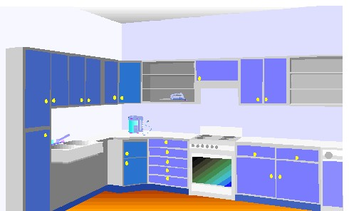
The Kitchen – die Küche
in the kitchen – in der Küche

Slide 4
The living room – das Wohnzimmer
In the living room – Im Wohnzimmer

Slide 5
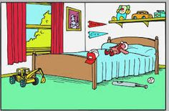
The bedroom – das Schlafzimmer
In the bedroom – Im Schlafzimmer

Slide 6
The garden – der Garten
In the garden – Im Garten

Slide 7
Other rooms – andere Zimmer
The play (child’s) room
The office
The cellar
The guestroom
The window/s
The door/s
The hallway
The loft
Das Kinderzimmer
Das Büro
Der Keller
Das Gästezimmer
Das/die Fenster
Die Tür/die Türen
Der Flur
Das Loft

Slide 8
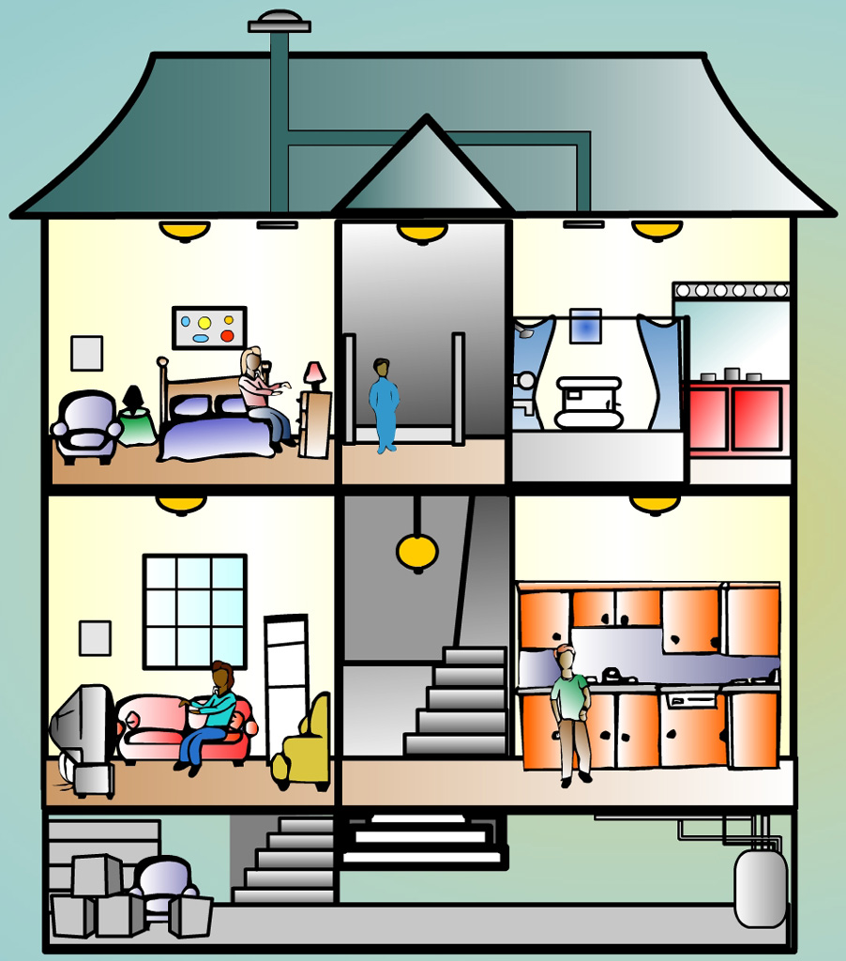
That is… – das ist … Here is… – hier ist …

Slide 9
House Charades

Slide 10
To be - Sein
I am
You are
He is
She is
It is
They are
We are
Ich bin
Du bist
Er ist
Sie ist
Es ist
Sie sind
Wir sind

Slide 11
Translate – Übersetzen Sie
I am in the kitchen
You are in the living room
He is in the bedroom
She is in the garden
It is in the playroom
They are in the cellar
We are in the loft
Are you in the office?

Slide 12
?
Who is speaking?

Slide 13
House 1 and Rooms Haus 1 und Zimmer
LO: Talk about a house
SC
I can name the rooms in a house
I can identify a room from a picture
I can play charades in German
I can use the German verb ‘to be’
I can translate sentences about a house by using ‘to be’

