Slide 1
www.zeitfuerdeutsch.com

Slide 2
The colours – Die Farben
LO: Know the colours in German
SC
I can point to something when told a colour in German
I can say ‘that is’ or ‘that is not’ a colour
I can tell someone what my favourite colour is

Slide 3
Card Swap - Kartentausch
Yes, correct
No, incorrect
Almost
Ja, Richtig
Nein, Falsch
Fast

Slide 4
Rot

Slide 5
Gelb

Slide 6
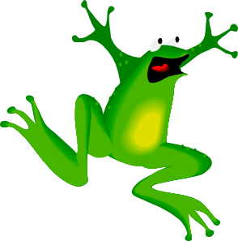
Grün

Slide 7
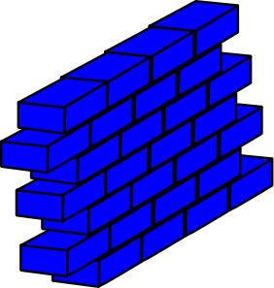
Blau

Slide 8
Schwarz

Slide 9
Weiß

Slide 10
Rosa

Slide 11
Braun

Slide 12
Lila

Slide 13
Orange

Slide 14
Grau

Slide 15
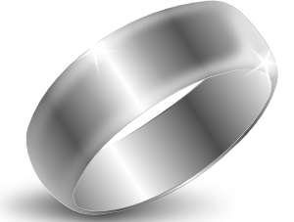
Silber

Slide 16
Gold

Slide 17
Bean Bag Pass
Which colour is that?
That is ...
Is that ...?
Yes
No
Welche Farbe ist das?
Das ist ...
Ist das ...
Ja
Nein

Slide 18
Colours - Farben
Multicoloured
Dark
Light
Dark blue
Light blue
And
Show me something that is ...
Bunt
Dunkel
Hell
Dunkelblau
Hellblau
Und
Zeigt mir etwas, das
... ist

Slide 19
Your favourite colour Deine Lieblingsfarbe
What is your favourite colour?
My favourite colour is ...
Was ist deine Lieblingsfarbe?
Meine Lieblingsfarbe ist ...
Turn Toss

Slide 20
The colours – Die Farben
LO: Know the colours in German
SC
I can point to something when told a colour in German
I can say ‘that is’ or ‘that is not’ a colour
I can tell someone what my favourite colour is

