Slide 1
www.zeitfuerdeutsch.com

Slide 2
Modal Verbs 1
LO: Use Modal Verbs
SC
I know what a modal verb is
I can conjugate 6 modal verbs
I can translate sentences with modal verbs into German
I can make up sentences with modal verbs and other verbs

Slide 3
Das Kartenspiel
Yes, correct
No, incorrect
Good
Super
Excellent
Fantastic
Brilliant
Wonderful
Great
Tremendous/super/great
Beautiful/great
Ja, Richtig
Nein, Falsch
Gut
Super
Ausgezeichnet
Fantastisch
Brilliant
Wunderbar
Großartig
Prima
Schön

Slide 4
What is a modal verb?
We use modal verbs to show if we believe something is certain, probable or possible (or not).
We also use modals to do things like talking about ability, asking permission making requests and offers, and so on.
English modal verbs include must, shall, will, should, would, can, could, may, and might.

Slide 5
To be able to - Können
I can
You can
He can
She can
It can
They can
We can
Ich kann
Du kannst
Er kann
Sie kann
Es kann
Sie können
Wir können

Slide 6
To have to - Müssen
I have to (must)
You have to
He has to
She has to
It has to
They have to
We have to
Ich muss
Du musst
Er muss
Sie muss
Es muss
Sie müssen
Wir müssen

Slide 7
To want - Wollen
I want
You want
He wants
She wants
It wants
They want
We want
Ich will
Du willst
Er will
Sie will
Es will
Sie wollen
Wir wollen

Slide 8
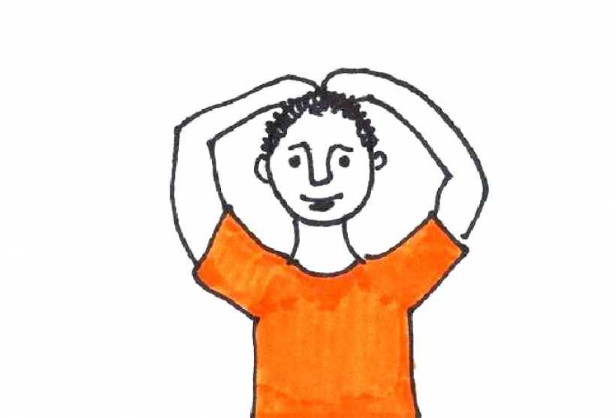
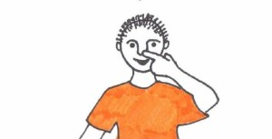
Secret Signal

Slide 9
To be allowed to - dürfen
I may/am allowed to
You may/are allowed to
He may/is allowed to
She may
It may
They may
We may
Ich darf
Du darfst
Er darf
Sie darf
Es darf
Sie dürfen
Wir dürfen

Slide 10
To like - mögen
I like
You like
He likes
She likes
It likes
They like
We like
Ich mag
Du magst
Er mag
Sie mag
Es mag
Sie mögen
Wir mögen

Slide 11
To be supposed to - sollen
I should/am supposed to
You should/are supposed to
He should/is supposed to
She should
It should
They should
We should
Ich soll
Du sollst
Er soll
Sie soll
Es soll
Sie sollen
Wir sollen

Slide 12
Verbs learnt so far
To play
To dance
To sing
To read
To do/to make
To hear/to listen to
To watch TV
To swim
To run
To do gymnastics
To speak
Spielen
Tanzen
Singen
Lesen
Machen
Hören
Fernsehen
Schwimmen
Rennen
Turnen
Sprechen

Slide 13
Verbs learnt so far
To be
To have
To have on
To eat
To drink
To visit
To travel
To be called
To shine
To rain
To snow
Sein
Haben
Anhaben
Essen
Trinken
Besuchen
Fahren
Heißen
Sheinen
Regnen
Schneien

Slide 14
Translate
I like to play
You should read
He can dance
She has to run
We are allowed to do it
I want to visit my uncle
They can speak German
Ich mag spielen
Du sollst lesen
Er kann tanzen
Sie muss rennen
Wir dürfen es machen
Ich will mein Onkel besuchen
Sie können Deutsch sprechen

Slide 15
?
What did they say?

Slide 16
Verb Charades

Slide 17
Modal Verbs 1
LO: Use Modal Verbs
SC
I know what a modal verb is
I can conjugate 6 modal verbs
I can translate sentences with modal verbs into German
I can make up sentences with modal verbs and other verbs

