Slide 1
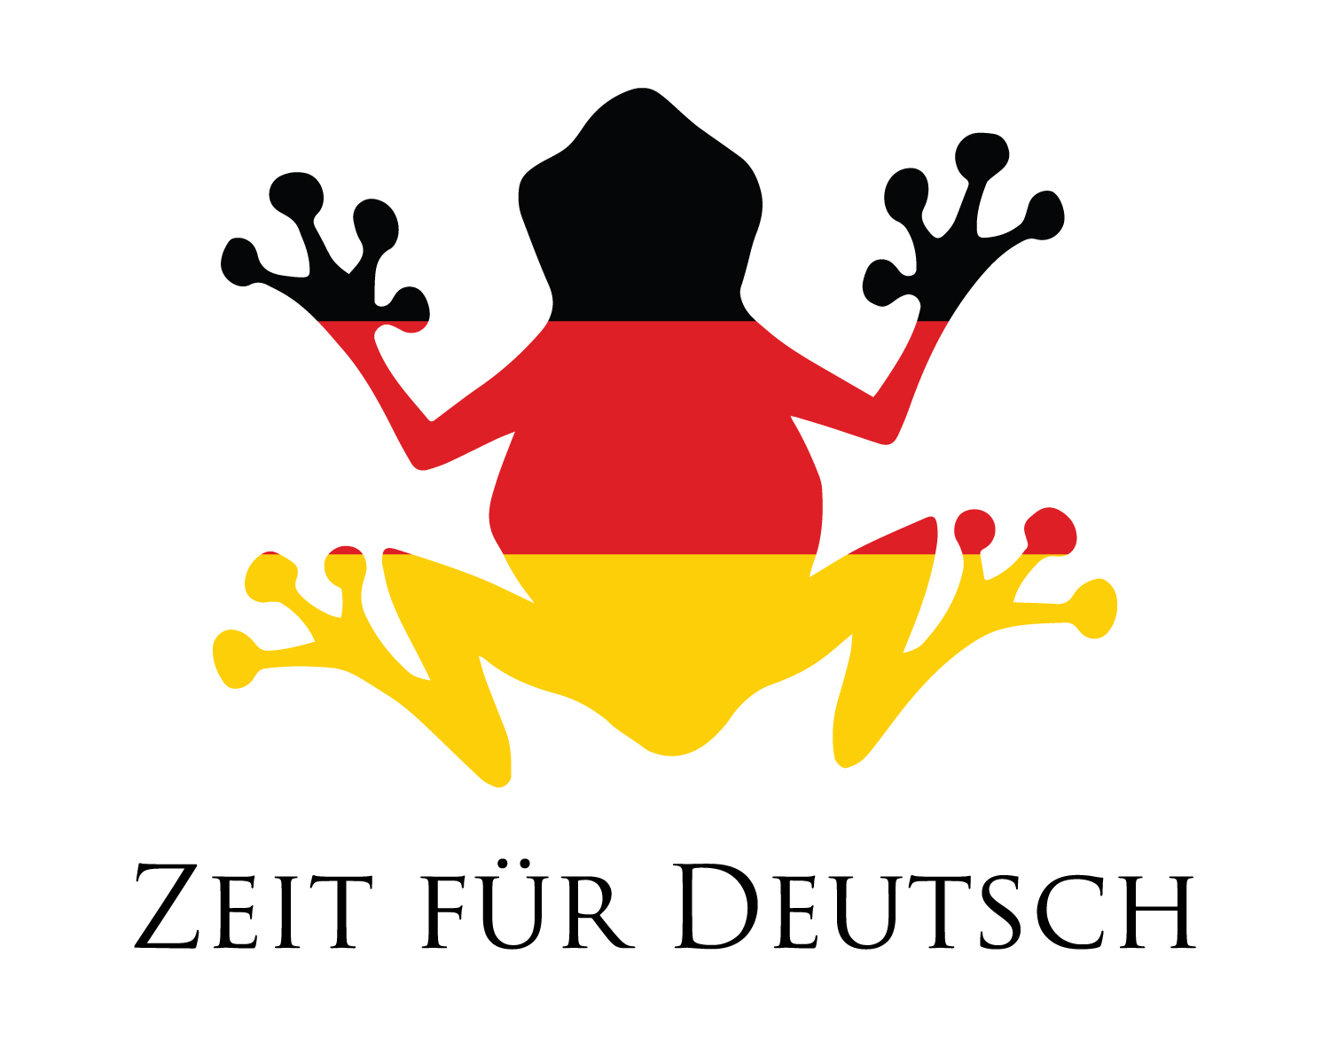
www.zeitfuerdeutsch.com

Slide 2
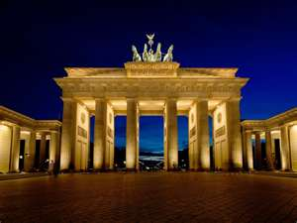
German Dictionary 1
LO: Use an English-German Dictionary
SC
I can say what different types of words are
I can find different types of words in a dictionary
I can use the English and German sides of a dictionary
I can name 10 new animals
I can find new adjectives to describe the animals

Slide 3
Das Kartenspiel
Yes, correct
No, incorrect
Good
Super
Excellent
Fantastic
Brilliant
Wonderful
Great
Tremendous/super/great
Beautiful/great
Ja, Richtig
Nein, Falsch
Gut
Super
Ausgezeichnet
Fantastisch
Brilliant
Wunderbar
Großartig
Prima
Schön

Slide 5
Types of Word
Noun (m, f, nt, pl) – Any word that you can put ‘the’ in front of
Example – I like the cat – Ich mag die Katze
Adjective (adj) – describes a noun
Example – They have a big house
Sie haben ein großes Haus
Verb (vb) – describes and action, state or occurrence
Example – I like to listen to music
Ich höre gern Musik

Slide 6
Types of Word
Preposition (prep) – A small word that links to others in a sentence
Example – The pencil is behind the glue
Der Bleistift ist hinter dem Kleber
Conjunction (conj) – Connects sentences or clauses and coordinates words
Example – I like onions but I prefer grapes
Ich mag Zwiebeln aber ich mag Trauben lieber
Pronoun (pron) – ‘Personal’ word that can take the place of a noun
Example – We are strong - Wir sind stark

Slide 7
Example – I like the cat – Ich mag die Katze
Example – They have a big house
Sie haben ein großes Haus
Example – I like to listen to music
Ich höre gern Musik
Example – The pencil is behind the glue
Der Bleistift ist hinter dem Kleber
Example – I like onions but I prefer grapes
Ich mag Zwiebeln aber ich mag Trauben lieber
Example – We are strong - Wir sind stark

Slide 8
Dictionary Work

Slide 9
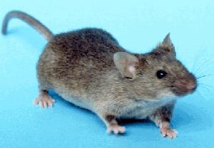
The mouse – die Maus

Slide 10
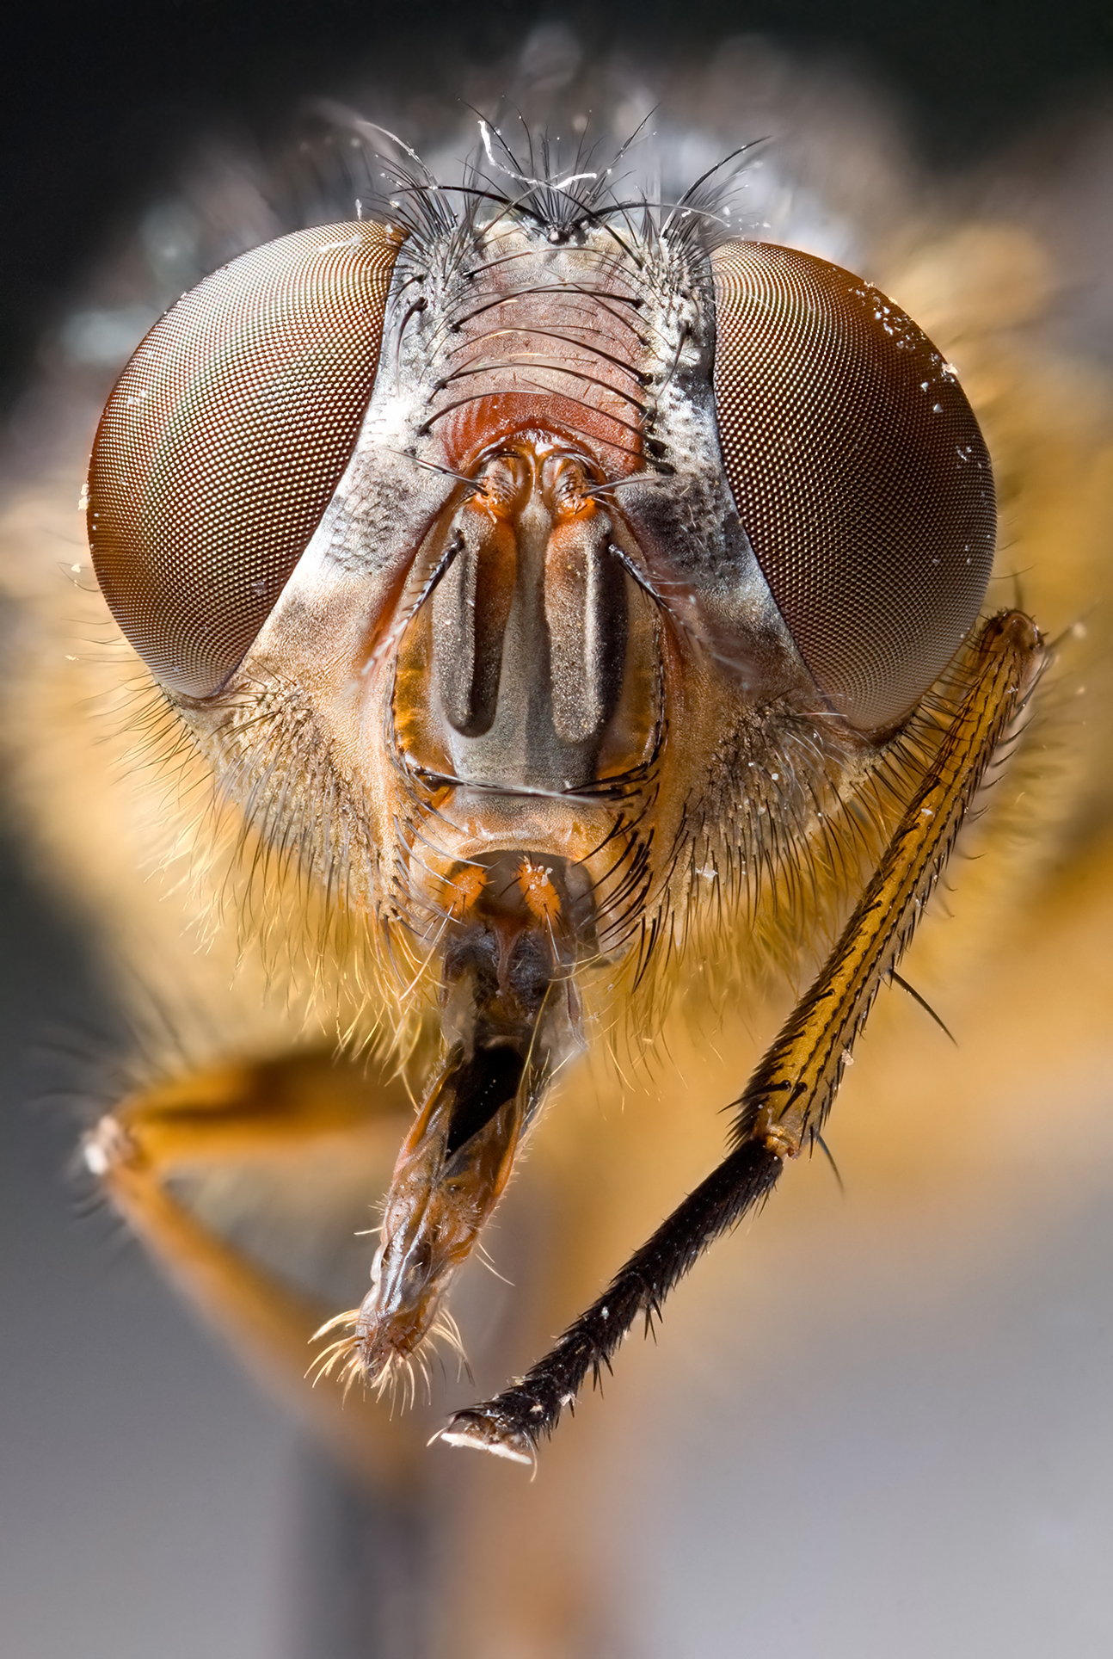
The insect – das Insekt

Slide 11
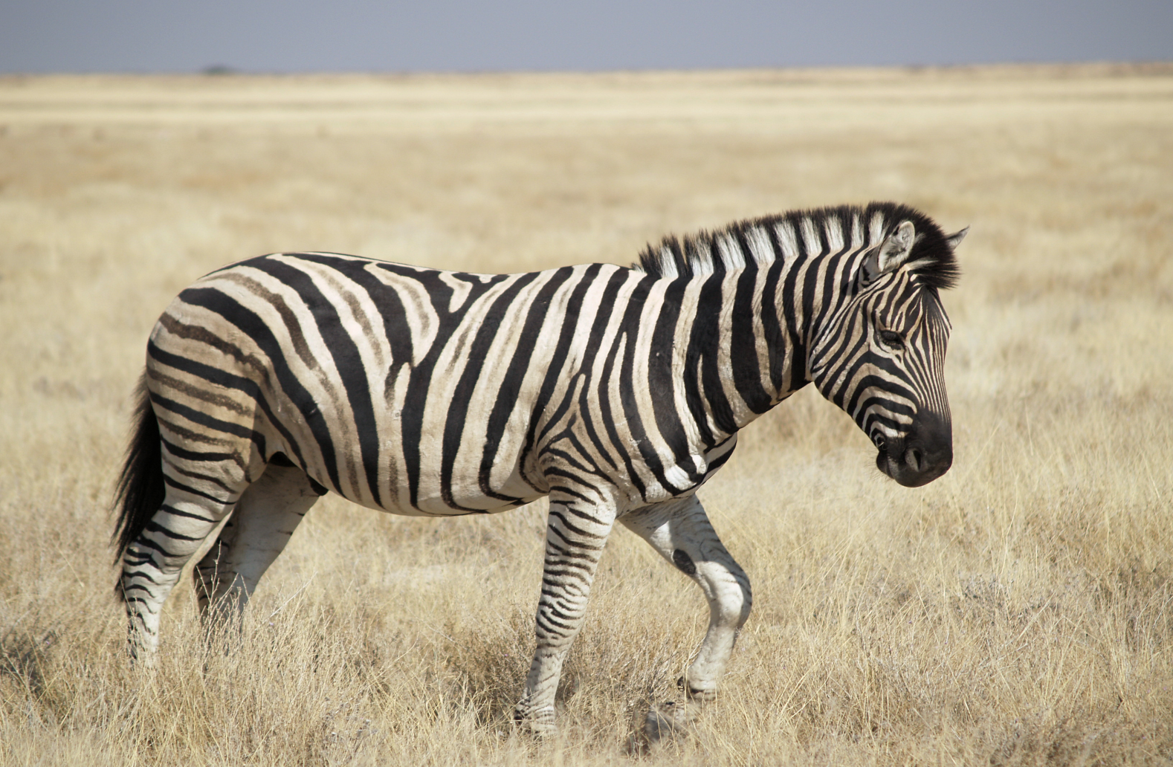
The zebra – das Zebra

Slide 12
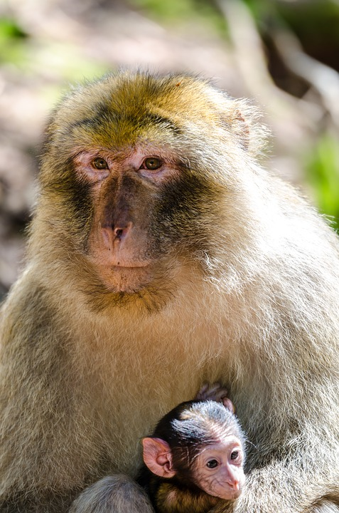
The monkey – der Affe

Slide 13
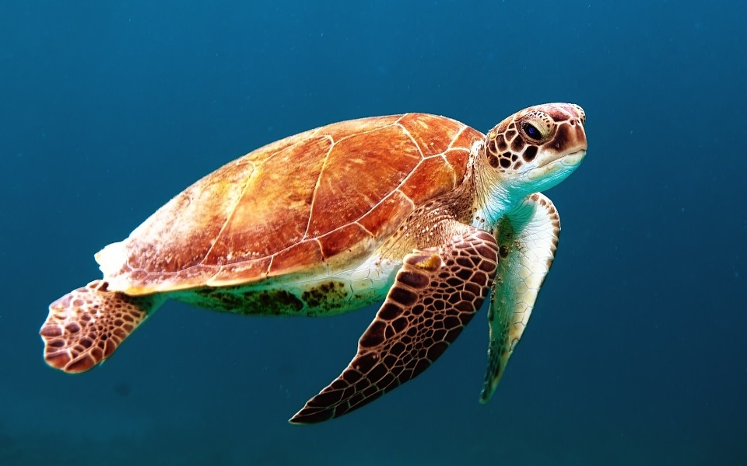
The turtle – die Schildkröte

Slide 14
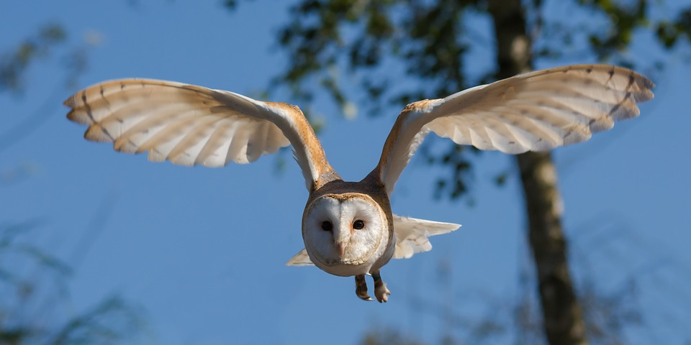
The owl – die Eule

Slide 15
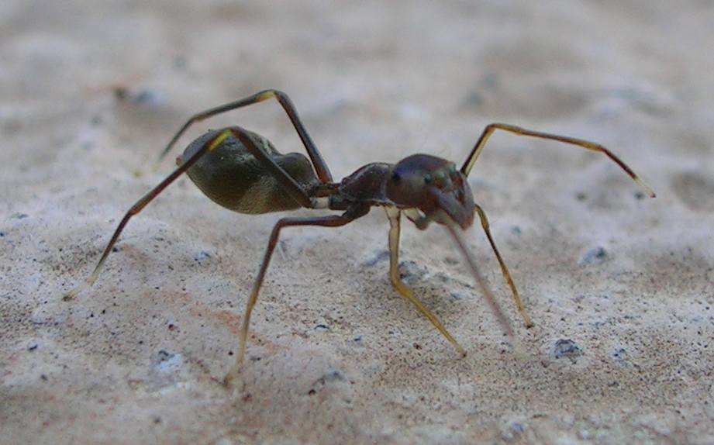
The spider – die Spinne

Slide 16
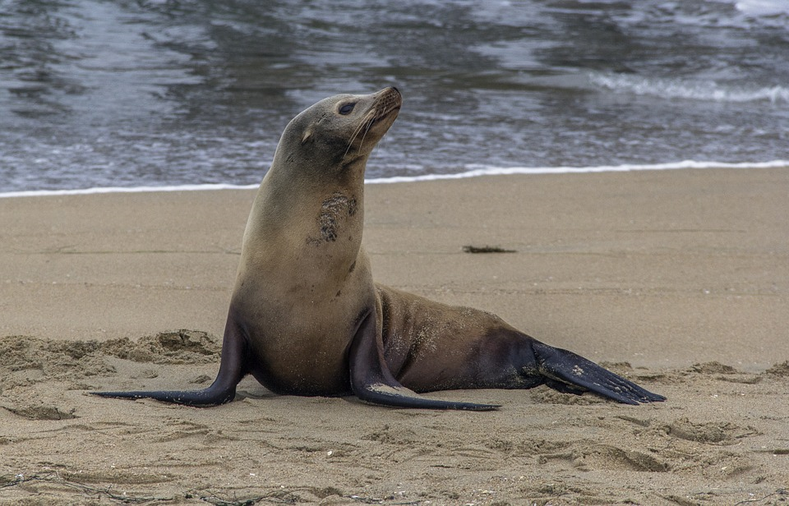
The seal – der Seehund

Slide 17
The human – der Mensch

Slide 18
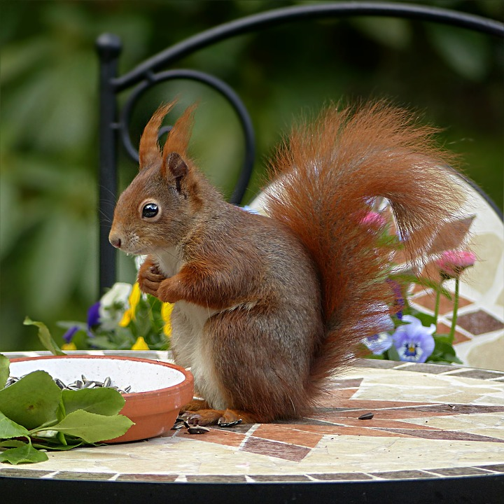
The squirrel – das Eichhörnchen

Slide 19
Animals and Adjectives
The ……… is ………….
Die Maus ist winzig - The mouse is tiny

Slide 20
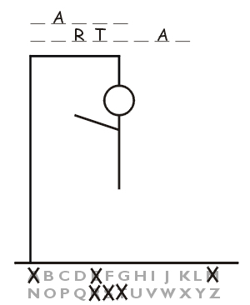
Dictionary Hangman
Animals and Adjectives

Slide 21
German Dictionary 1
LO: Use an English-German Dictionary
SC
I can say what different types of words are
I can find different types of words in a dictionary
I can use the English and German sides of a dictionary
I can name 10 new animals
I can find new adjectives to describe the animals

