Slide 1
www.zeitfuerdeutsch.com

Slide 2
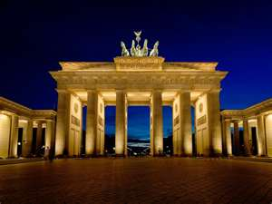
Weekdays 2 with Activities
LO: Say what I do on some days of the week
SC
I can say the days of the week in German
I can listen to an activity and mime the action
I can memorise sentence about the days of the week and tell my partner
I can sing a song about the days of the week
I can create a poster saying what I do and what Felix does on a certain day of the week

Slide 3
The days of the week – die Wochentage
Montag
Dienstag
Mittwoch
Donnerstag
Freitag
Samstag
Sonntag

Slide 4
On Monday must dad go to work early
Tuesday we want to go to the open air swimming pool
On Wednesday I must go to the dentist, oh no
Thursday Granny comes to visit, hooray
On Friday I always have football training
This Saturday, I (we) go to the zoo
Sunday is the seventh day of the week
do, do, do, do, do, do, do, do, do
Am Montag muss der Papa früh zu Arbeit
Dienstag wollen wir ins Freibad gehen
Am Mittwoch, da muss ich dann zum Zahnartzt, och no
Donnerstag kommt Oma zum Besuch, Hurra!
Am Freitag habe ich immer Fußballtraining
Diesen Samstag, da geht es in den Zoo
Sonntag ist der siebte Tag der Woche
do, do, do, do, do, do, do, do, do

Slide 5
(The) Activities – (die) Aktivitäten
What does Felix do on Monday?
What does he/she do on Tuesday?
What do you do on Wednesday?
What do you do on Thursday?
Was macht Felix am Montag?
Was macht er/sie am Dienstag?
Was machst du am Mittwoch?
Was machst du am Donnerstag?

Slide 6
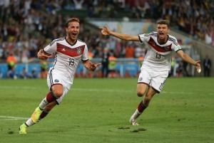
Play football– Fussball spielen
On Monday I play football
On Tuesday Felix/he/she plays football
Am Montag spiele ich Fussball
Am Dienstag spielt Felix/er/sie Fussball

Slide 7
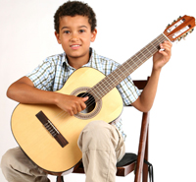
Play guitar – Gitarre spielen
On Wednesday I play guitar
On Thursday Felix/he/she plays guitar
Am Mittwoch spiele ich Gitarre
Am Donnerstag spielt Felix /er/sie Gitarre

Slide 8
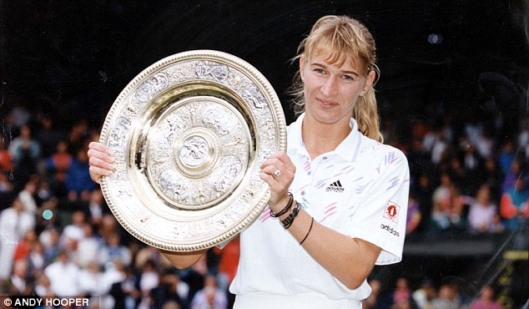
Play tennis – Tennis spielen
On Friday I play tennis
On Saturday Felix /he/she plays tennis
Am Freitag spiele ich Tennis
Am Samstag spielt Felix /er/sie Tennis

Slide 9
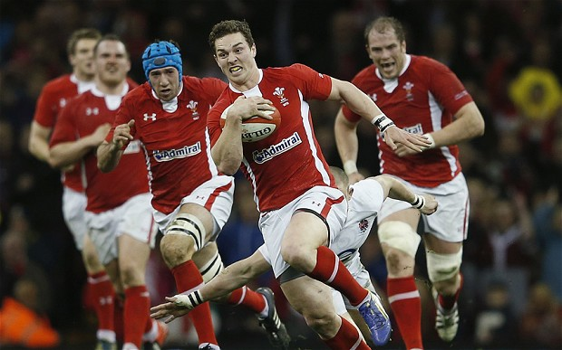
Play rugby – Rugby spielen
On Sunday I play rugby
On Monday Felix /he/she plays rugby
Am Sonntag spiele ich Rugby
Am Montag spielt Felix /er/sie Rugby

Slide 10
Play on the computer – am Computer spielen
On Tuesday I play on the computer
On Wednesday Felix /he/she plays on the computer
Am Dienstag spiele ich am Computer
Am Mittwoch spielt Felix /er/sie am Computer

Slide 11
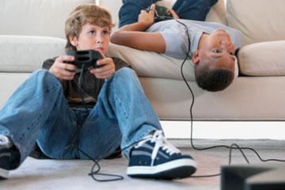
Play computer games – Computerspiele spielen
On Thursday I play computer games
On Friday Felix /he/she plays computer games
Am Donnerstag spiele ich Computerspiele
Am Freitag spielt Felix /er/sie Computerspiele

Slide 12
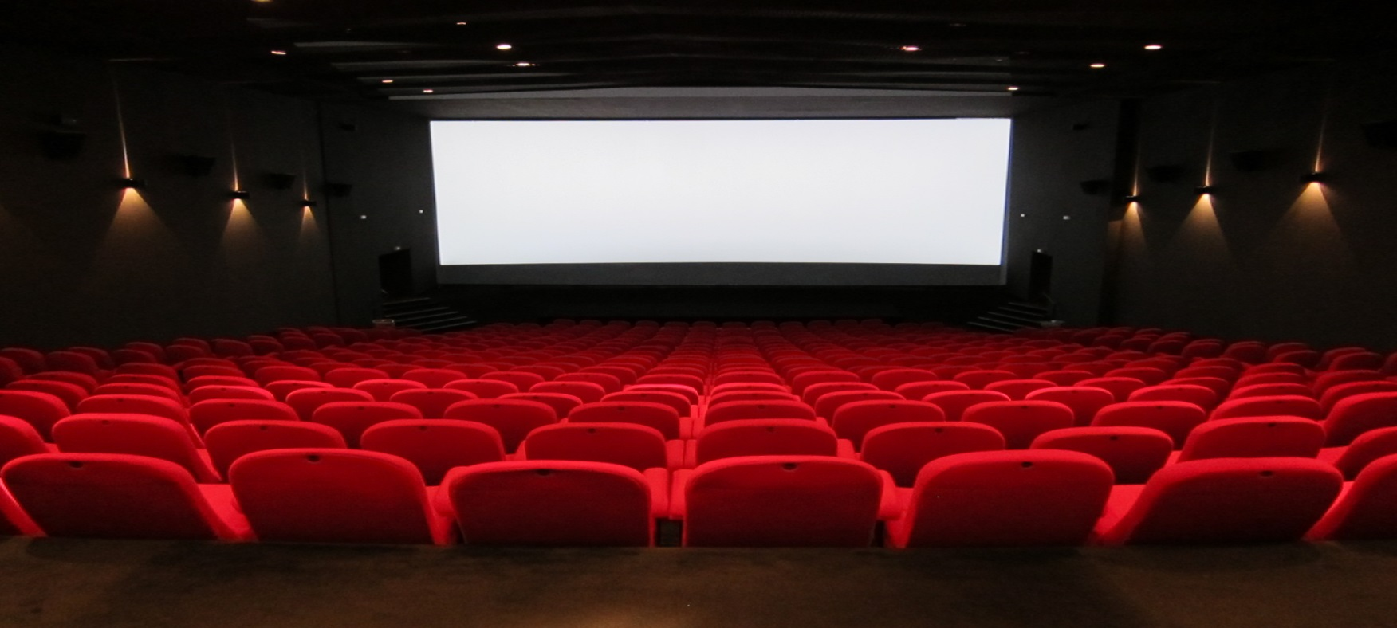
Go to the cinema – ins Kino gehen
On Saturday I go to the cinema
On Sunday Felix /he/she goes to the cinema
Am Samstag gehe ich ins Kino
Am Sonntag geht Felix /er/sie ins Kino

Slide 13
Stay at home – zu Hause bleiben
On Saturday I stay at home
On Sunday Felix /he/she stays at home
Am Samstag bleibe ich zu Hause
Am Sonntag bleibt Felix /er/sie zu Hause

Slide 14
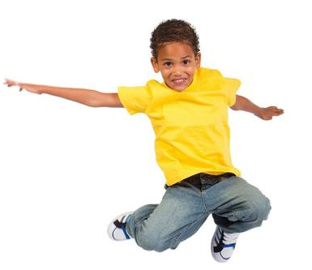
Hans sagt – Hans (Simon) says
(The) Activities – (die) Aktivitäten

Slide 15
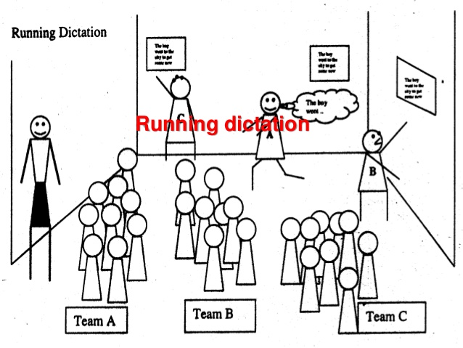
Running Dictation

Slide 16
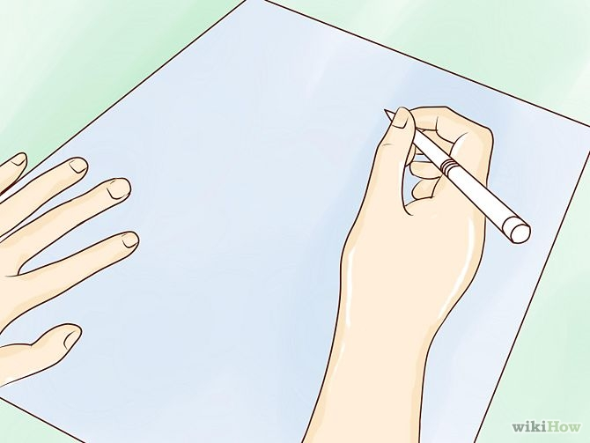
Make a German poster

Slide 17
Weekdays 2 with Activities
LO: Say what I do on some days of the week
SC
I can say the days of the week in German
I can listen to an activity and mime the action
I can memorise sentence about the days of the week and tell my partner
I can sing a song about the days of the week
I can create a poster saying what I do and what Felix does on a certain day of the week

