Slide 1
www.zeitfuerdeutsch.com

Slide 2
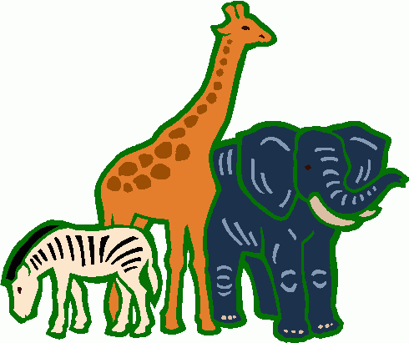
The animal/s 1 – Das Tier/ Die Tiere 1
LO: Name and describe animals
SC
I know the German word for 10 animals
I can describe the animals
I can guess what animal someone is describing

Slide 3
Das Kartenspiel
Yes, correct
No, incorrect
Good
Super
Excellent
Fantastic
Brilliant
Wonderful
Great
Tremendous/super/great
Beautiful/great
Ja, Richtig
Nein, Falsch
Gut
Super
Ausgezeichnet
Fantastisch
Brilliant
Wunderbar
Großartig
Prima
Schön

Slide 4
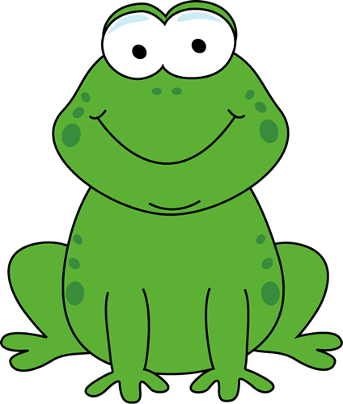
The frog – Der Frosch

Slide 5
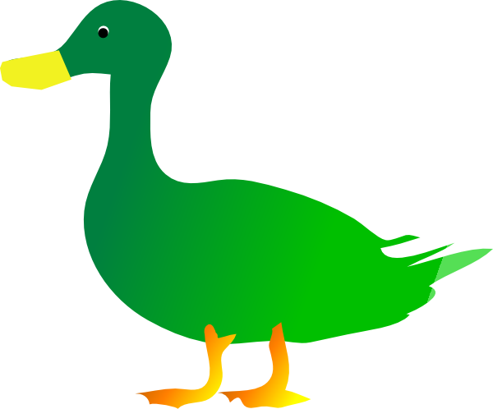
The duck – Die Ente

Slide 6
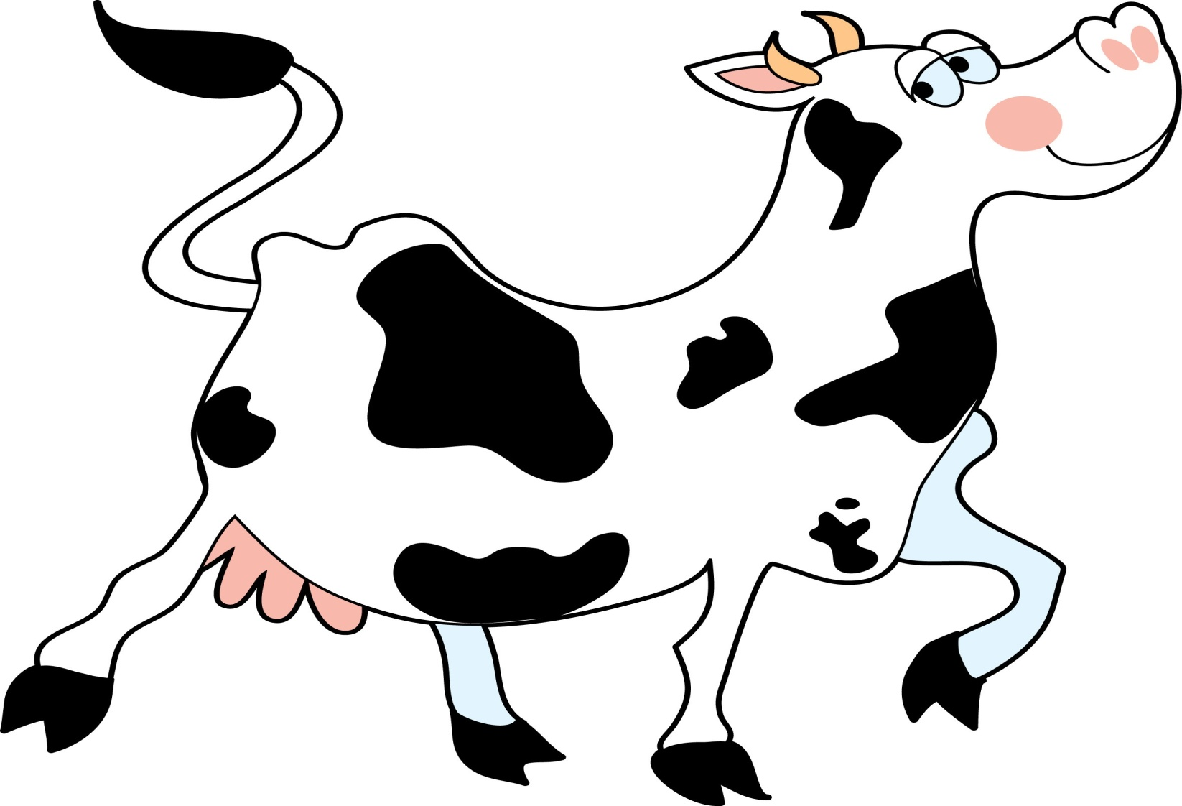
The cow – Die Kuh

Slide 7
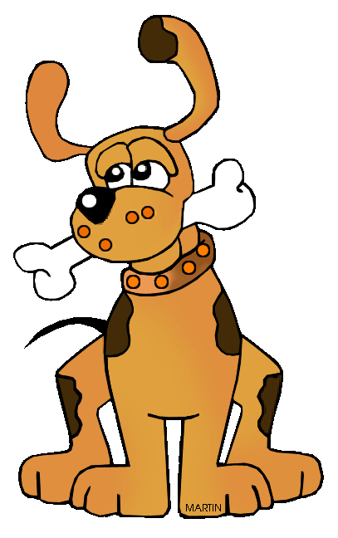
The dog – Der Hund

Slide 8
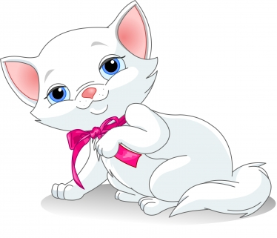
The cat – Die Katze

Slide 9
The bee – Die Biene

Slide 10
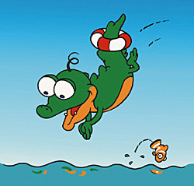
The crocodile – das Krokodil

Slide 11
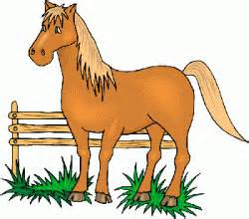
The horse – Das Pferd

Slide 12
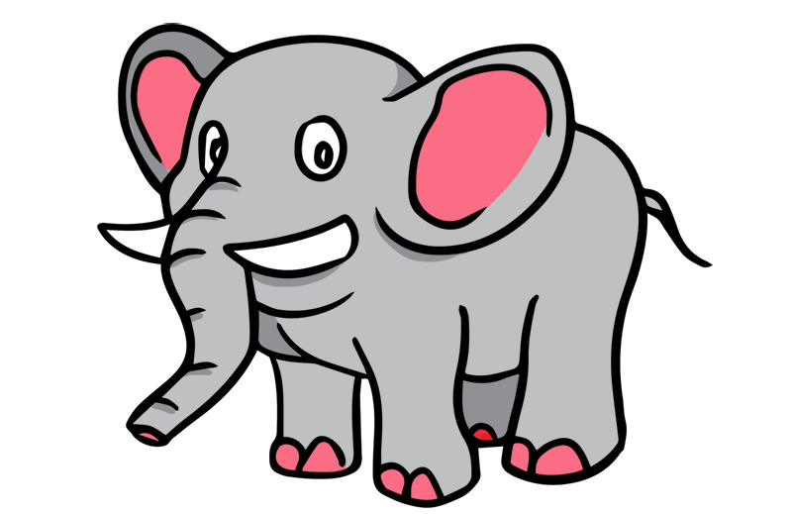
The elephant – Der Elefant

Slide 13
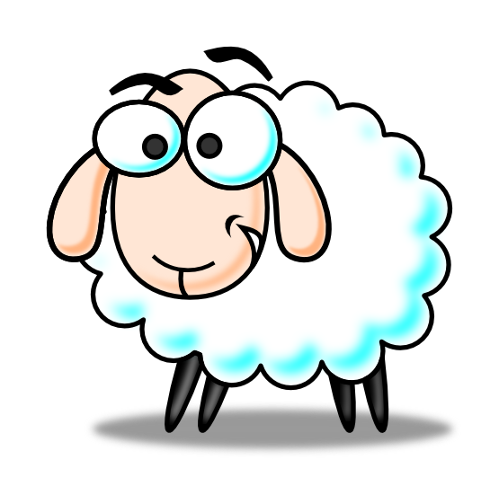
The sheep – das Schaf

Slide 14
Animal Mime
Bist du der/die/das ...?
Ja, ich bin der/die/das...
Nein, ich bin nicht der/die/das...
Are you the ...?
Yes, I am the ...
No, I am not the ....

Slide 15
Welches Tier bin ich? - Which animal am I?
Ich bin ...
Laut
Leise
Schnell
Langsam
Groß
Klein
Normaleweise
Ich habe ... (braune Haare)/vier Beine
I am ...
Loud
Quiet
Fast/Quick
Slow
Big/Tall
Small/Short
Normally
I have ... brown hair/
four legs

Slide 16
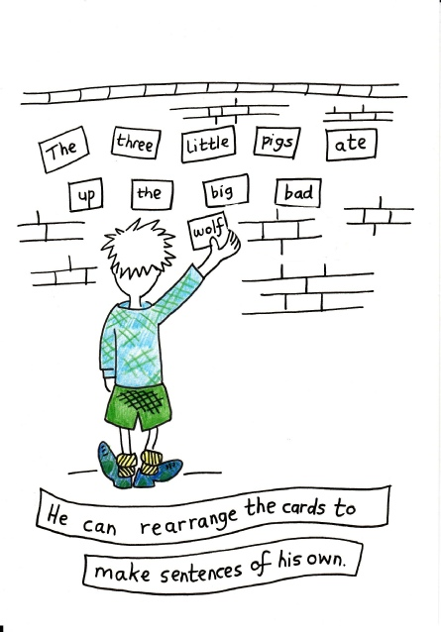
Make a Sentence

Slide 17
The animal/s 1 – Das Tier/ Die Tiere 1
LO: Name and describe animals
SC
I know the German word for 10 animals
I can describe the animals
I can guess what animal someone is describing

