Slide 1
www.zeitfuerdeutsch.com

Slide 2
To have 2 – Haben 2
LO: Use ‘to have’ in a variety of situations
SC
I can use ‘to have’ when talking about family
I can use ‘to have’ when talking about birthdays
I can translate ‘to have’ sentences on my own and with a partner
I can play ‘hangman’ and ‘running dictation’ in German

Slide 3
To have - Haben
I have
You have
He has
She has
It has
They have
We have
Ich habe
Du hast
Er hat
Sie hat
Es hat
Sie haben
Wir haben

Slide 4
To have - Haben
I have
You have
You have
You have
He has
She has
It has
They have
We have
Ich habe
Du hast
Sie haben
Ihr habt
Er hat
Sie hat
Es hat
Sie haben
Wir haben

Slide 5
meine Familie
die Mutter
= the mum
der Papa
= the dad
der Bruder
= the brother

Slide 6
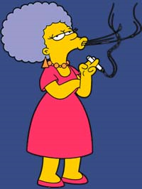
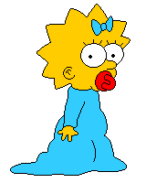
meine Familie
der Opa
= the grandad
die Tante
= the aunt
die Schwester
= the sister

Slide 7
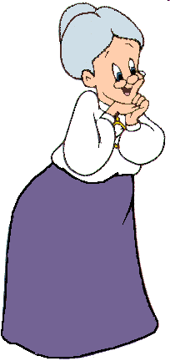
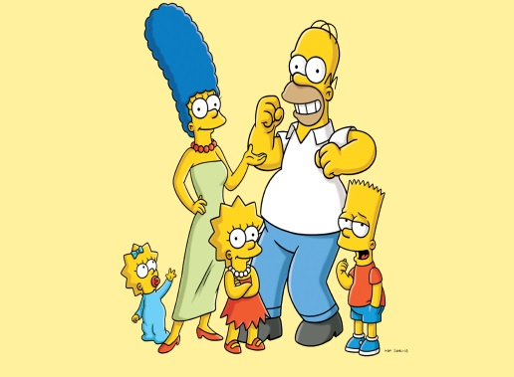
meine Familie
der Onkel
= the uncle
die Oma
= the granny
die Familie
= the family

Slide 8
meine Familie – neu Vokabeln
der Sohn
die Tochter
der Cousin/die Cousine
der/die Stief…
die Stiefmutter
der Stiefbruder
The son
The daughter
The cousin
The step …
The stepmother
The stepbrother

Slide 9
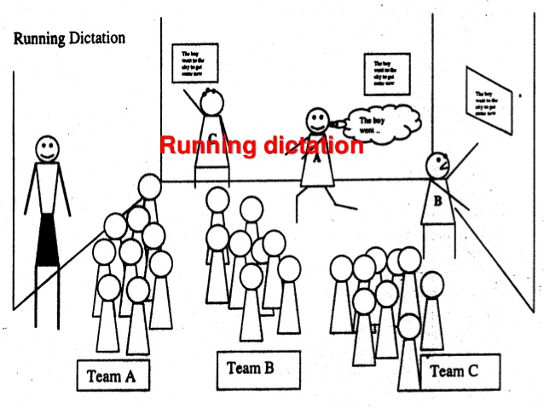
Running Dictation

Slide 10
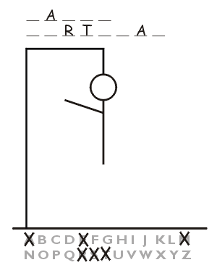
Hangman
Haben + Family

Slide 11
The months – Die Monate
January
February
March
April
May
June
July
August
September
October
November
December
Januar
Februar
März
April
Mai
Juni
Juli
August
September
Oktober
November
Dezember

Slide 12
The months – Die Monate
January
February
March
April
May
June
July
August
September
October
November
December

Slide 13
Ordinal Numbers
First
Second
Third
Fourth
Eleventh
Fifteenth
Twentieth
Twenty-sixth
Thirty-first
Ersten
Zweiten
Dritten
4 – 19 – add `ten` on the end
Vierten
Elften
Fünfzehnten
After 19 – add `sten`
Zwanzigsten
Sechsundzwanzigsten
Einunddreißigsten
Irregular – Just like English

Slide 14
1st
2nd
3rd
4th
5th
6th
7th
8th
9th
10th
11th
12th
13th
14th
15th
16th
Ersten
Zweiten
Dritten
Vierten
Fünften
Sechsten
Siebten
Achten
Neunten
Zehnten
Elften
Zwölften
Dreizehnten
Vierzehnten
Fünfzehnten
Sechszehnten
Siebzehnten
Achtzehnten
Neunzehnten
Zwanzigsten
Einundzwanzigsten
Zweiundzwanzigsten
Dreiundzwanzigsten
Vierundzwanzigsten
Fünfundzwanzigsten
Sechsundzwanzigsten
Siebenundzwanzigsten
Achtundzwanzigsten
Neunundzwanzigsten
Dreißigsten
Einunddreißigsten
zweiunddreißigsten
17th
18th
19th
20th
21st
22nd
23rd
24th
25th
26th
27th
28th
29th
30th
31st
32nd

Slide 15
On 5th January
On 21st February
On 12th March
On 25th April
On 3rd May
On 31st June
On 19th August
On 2nd December
On – am
4 – 19 – add `ten` on the end
After 19 – add `sten`

Slide 16
Fill in the ___________ and translate

Slide 17
Ich ______ am fünfzehnten April Geburtstag
Wir ______ am elften September Geburtstag
Du _______ am dritten Juni Geburtstag
Sie _______ am achtundzwanzigsten November Geburtstag
Er ________ am dreißigsten August geburtstag

Slide 18
Translate – Übersetzen Sie
I have on 12th May birthday – (Geburtstag)
You have on 23rd January birthday
It has on 5th October birthday
She has on 17th July birthday
He has on 30th December birthday
They have on 8th February birthday
We have on 20th August birthday
They have on 3rd March birthday

Slide 19
?
Who is speaking?

Slide 20
To have 2 – Haben 2
LO: Use ‘to have’ in a variety of situations
SC
I can use ‘to have’ when talking about family
I can use ‘to have’ when talking about birthdays
I can translate ‘to have’ sentences on my own and with a partner
I can play ‘hangman’ and ‘running dictation’ in German

